Slide 1


RIGA BUSINESS SCHOOL
FIRST YEAR SEMINAR
Team MBGA
Final Presentation
11.12.2019

Slide 2

Presentation Outline
TODAY'S DISCUSSION
Our Team
What we have built?
Initial Idea
Initial Stakeholders
Problem We're Solving
Change of the Idea
Test of the Solution
How Iterations Helped Us?
Our Website
The Future of Our Solution
Key Lessons
Contact Inforation

Slide 3
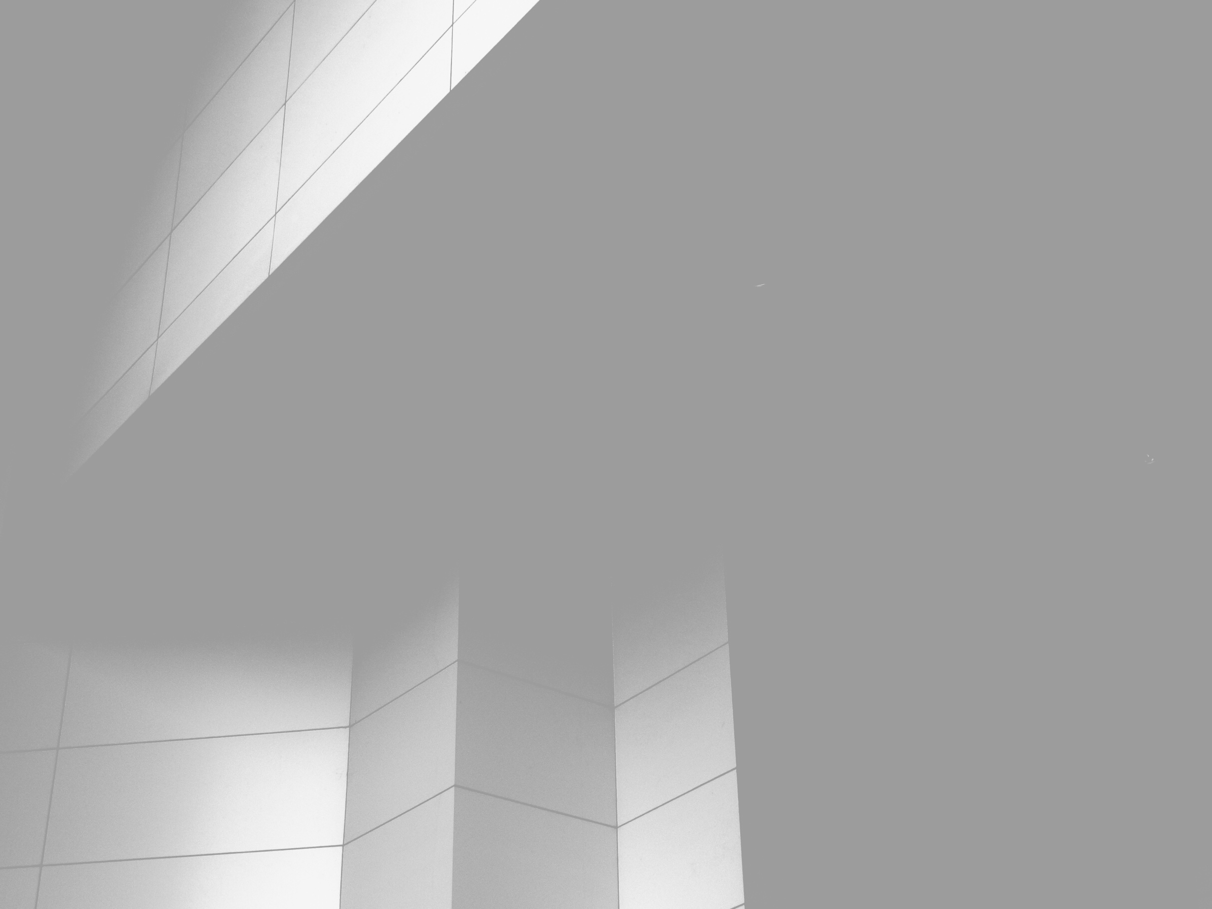
PUNCHLINE
We Will Make Bauska Great Again
TEAM MBGA

Slide 4

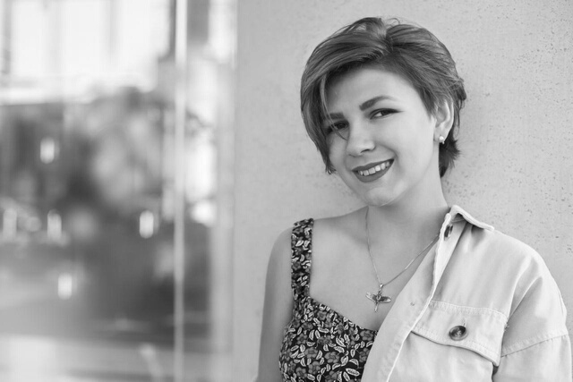
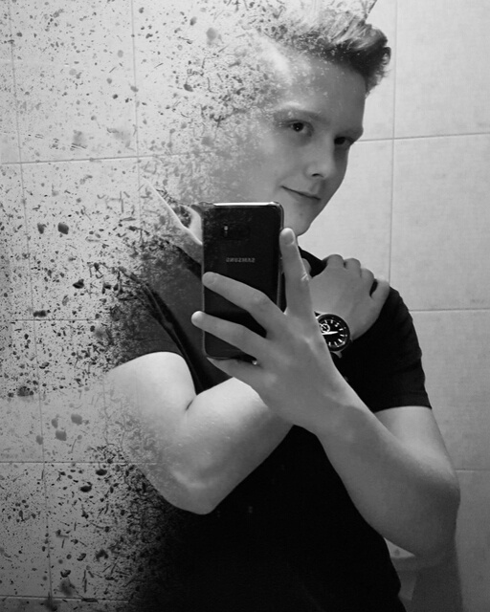
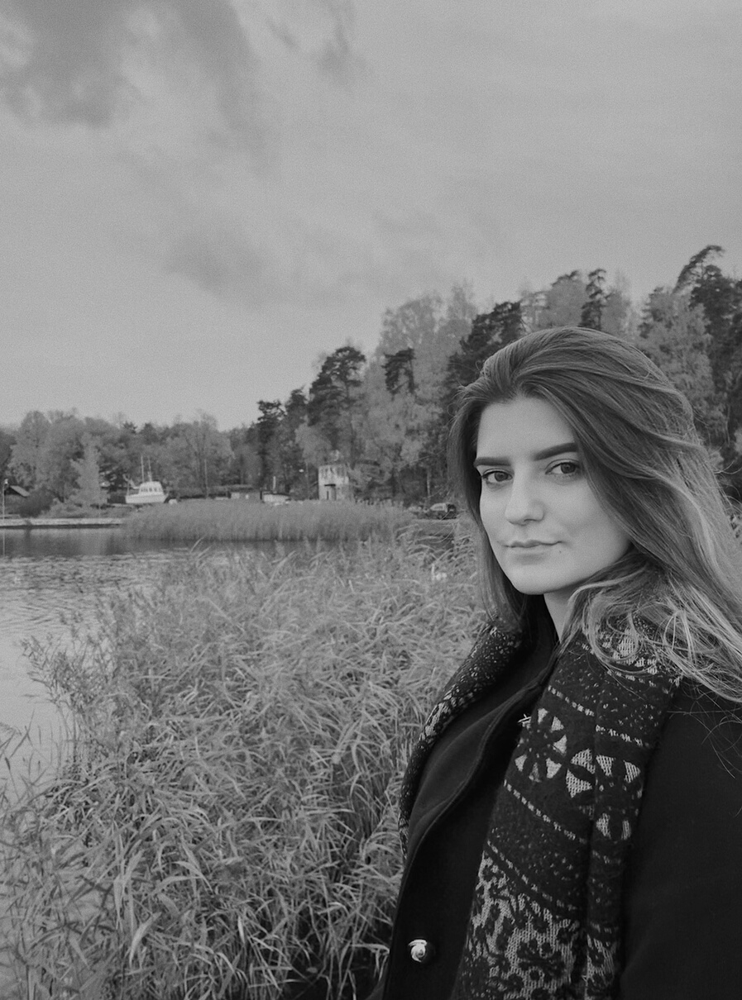
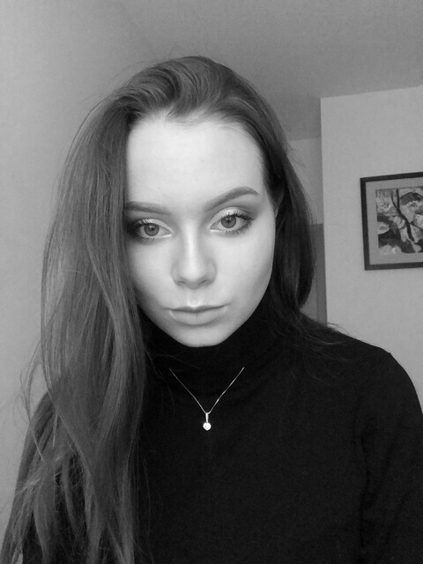
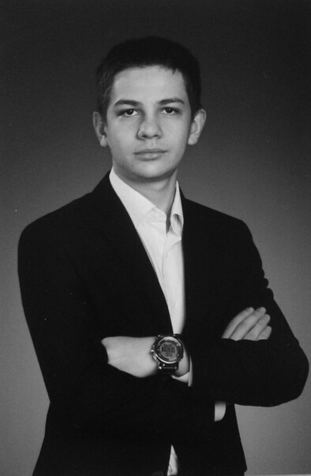
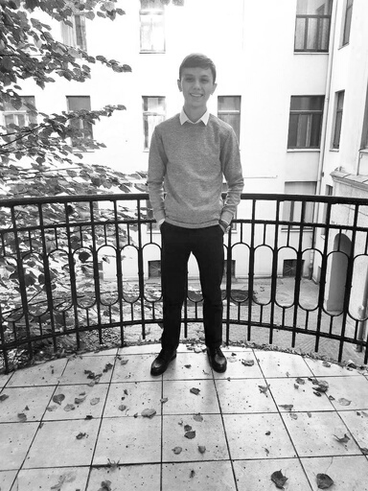
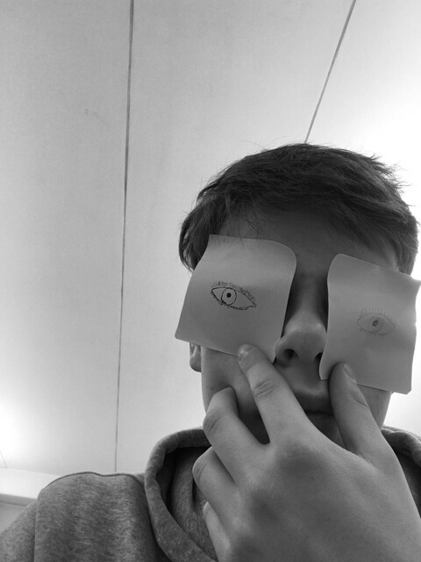
Meet the Team
SOFIA FOKINA
IGORS TATARINOVS
MARINA TUTARAŠVILI
JUDITE ZAKA
Project Management
Project Management
Design and User Experience
Design and User Experience
LEONIDS ROZINS
OTABEK KHAMIDOV
BORISS VERBICKIS
Customers and Communication
Software
Software

Slide 5
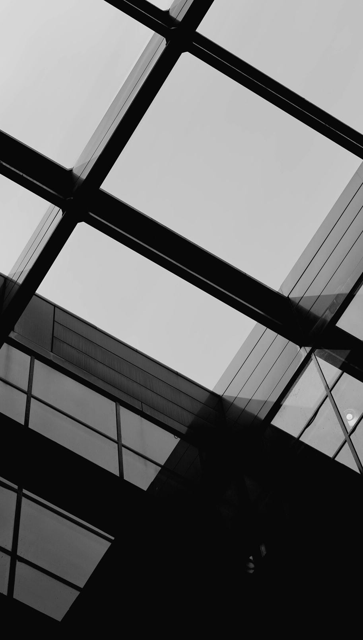
What we have built?
CONNECTING PLATFORM
Website with voting system for architectual students’ projects of installation

Slide 6
Initial idea
CONNECTING PLATFORM
Website with voting system for architectual students’ projects of buildings’ reconstruction

Slide 7
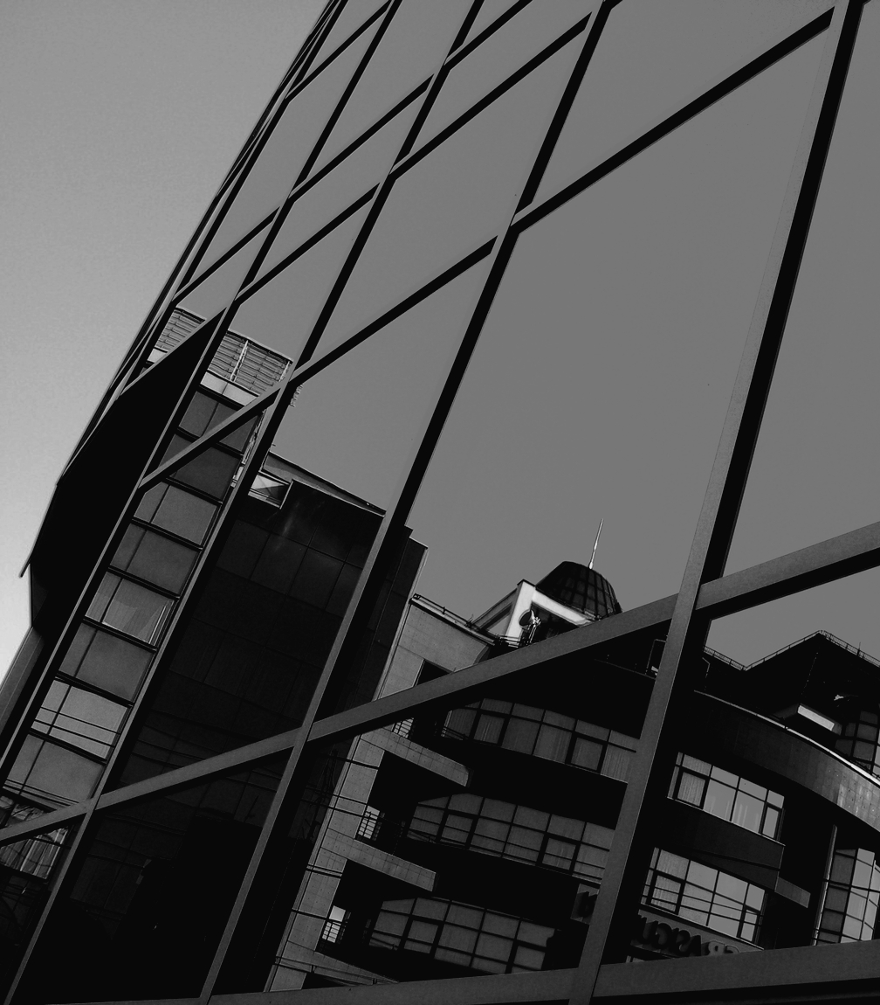
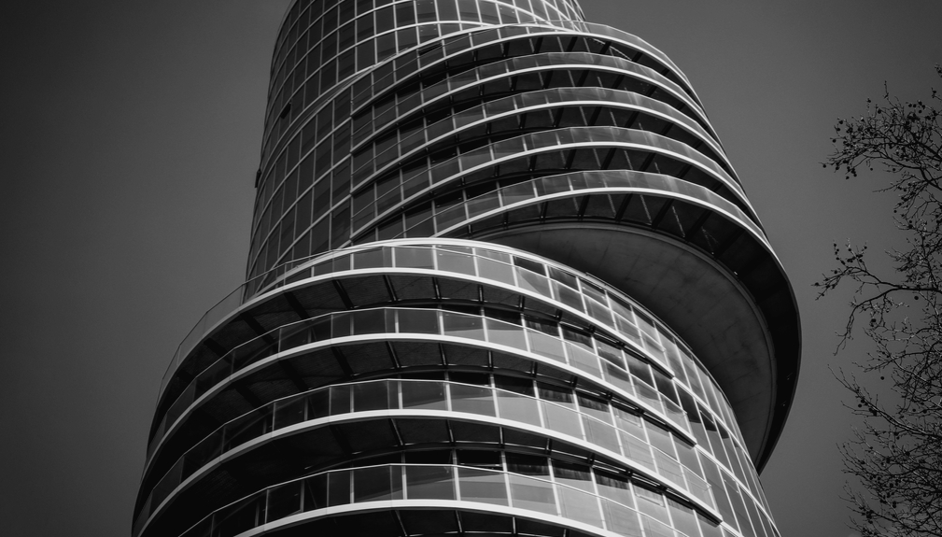
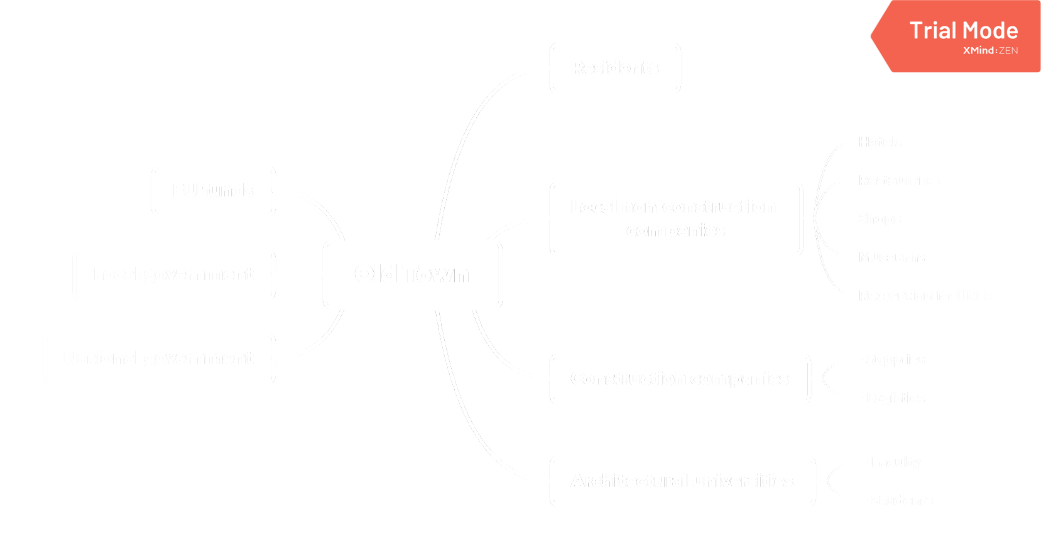
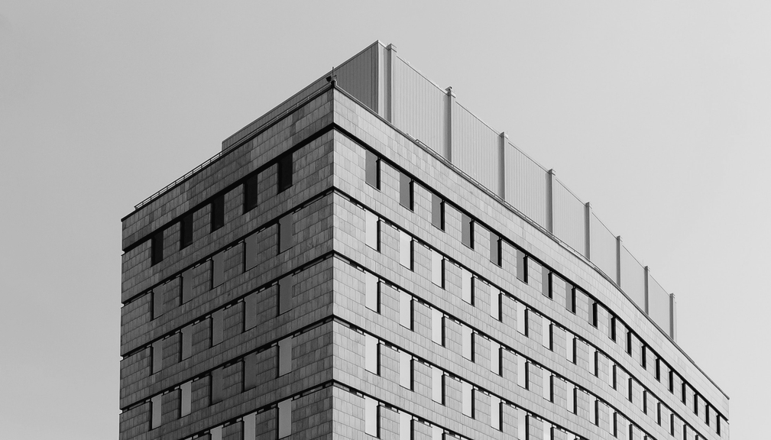

Slide 8

Problem We're Solving
HOW WE IDENTIFIED THE PROBLEM?
THE PROBLEM
Bad shape of Bauska's old town housing. Local residents don't fell that their opinions are considered.
Through a visit to Bauska and a visual inspection of the old town.

Slide 9
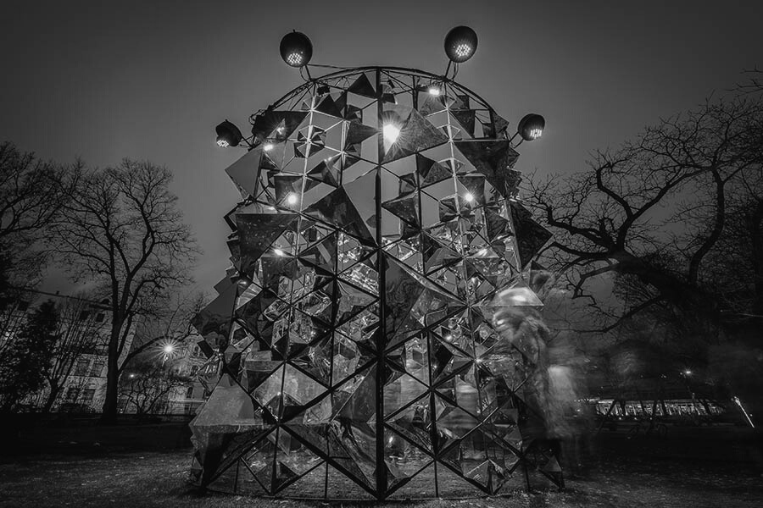
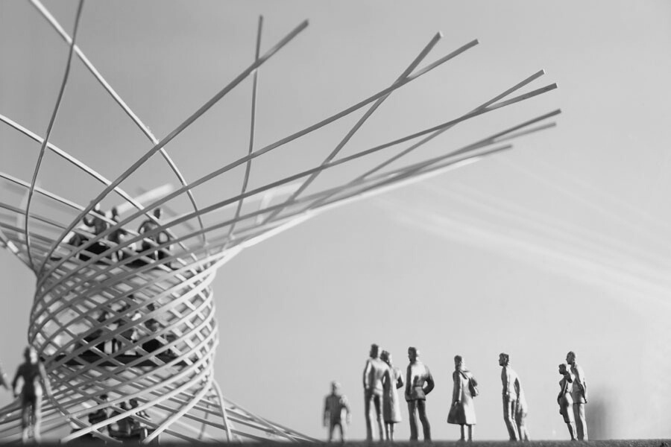
TO INSTALLATIONS IN THE CITY CENTER
We came up to the alternative solution of unique installation
CHANGE FROM THE FACADES
Because architecture students from RTU said that it will be very expensive to repair facades in the whole old city

Slide 10
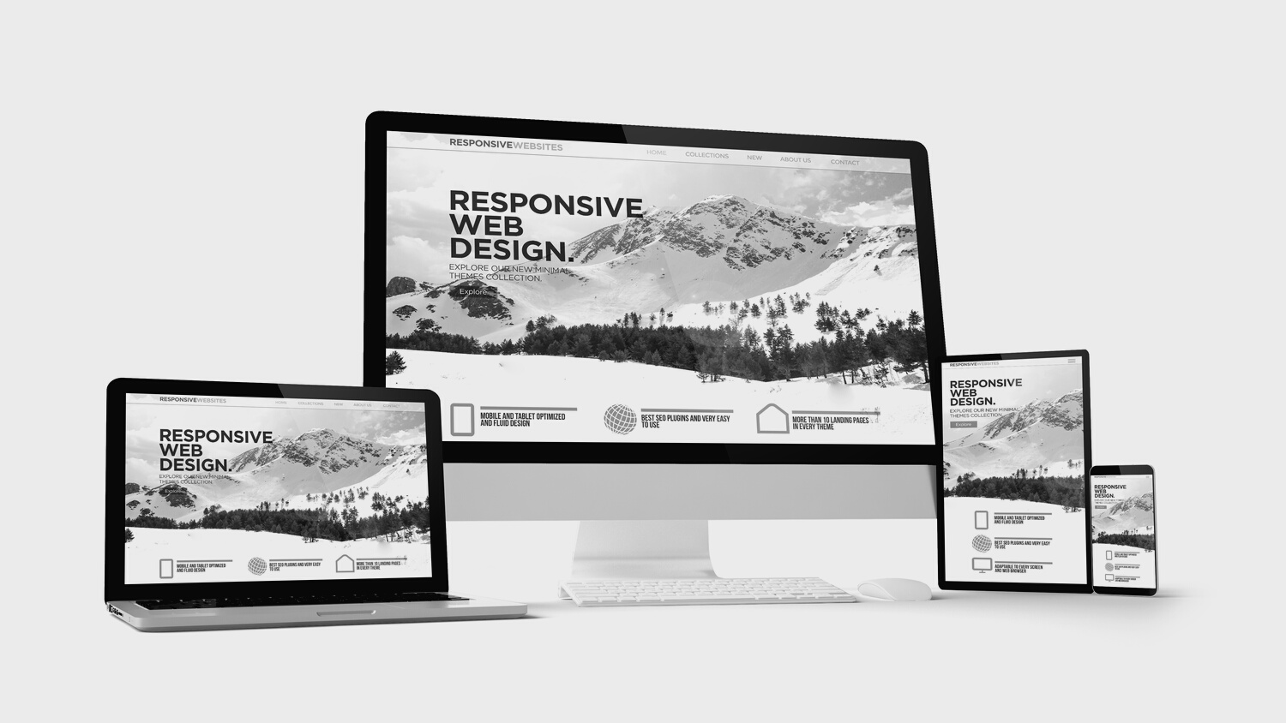
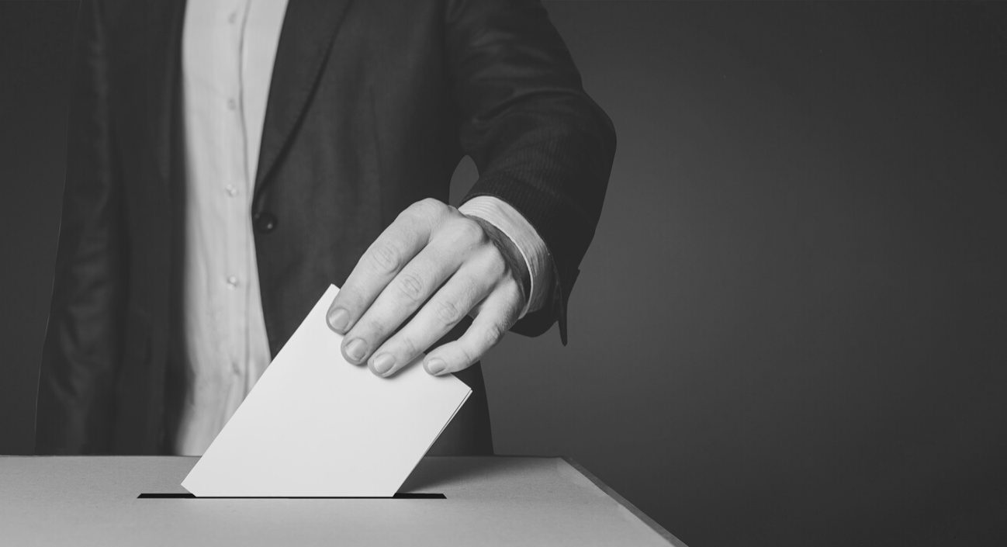

Test of the Solution
HOW WEBSITE WORKS ON DIFFERENT DEVICES
VOTING PROCESS
ANALYSIS OF THE RESULTS

Slide 11
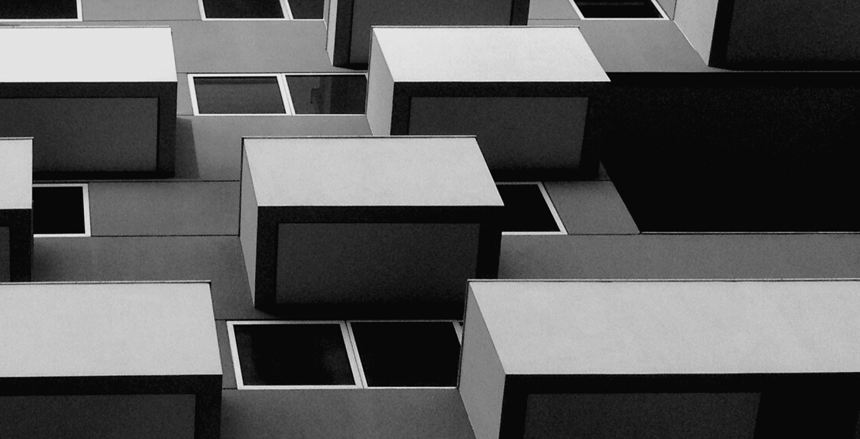
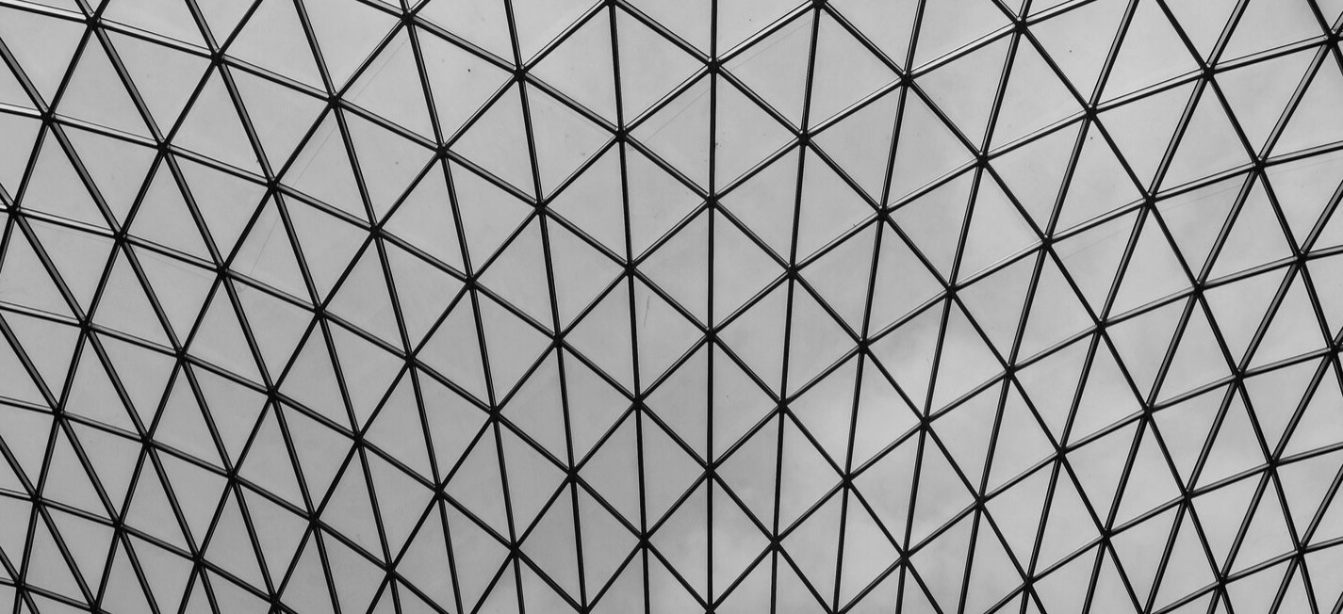
How Iterations Helped Us?
They helped to increase the performance working towards the project and not to change the focus from work to something else inadvertently. Moreover, they helped us to structurize working process

Slide 12
Ensure from Ieva that promotion of the platform will be provided and channels of promotion they will use for it
Ask Ieva for spreading through PR department surveys
Discuss details with architects and give contacts of Bauska gov in order to let them ensuring technical issues with them directly
15.10
26.11
Visit Bauska and reach stakeholders and receive a feedback about the project
Ensure from regional dev dep that prize will be provided to the winner
4.12
Meet with architects
Formulating and sending a full description of the project to Bauska
2.12
Filling with the content
8.12
20.09
Front-End developing
Back-End developing
Designing
Testing
10. 10
1.11
30.11
20.09
Formulating a problem, solution and determining main stakeholders
20.09
11.12

Slide 13
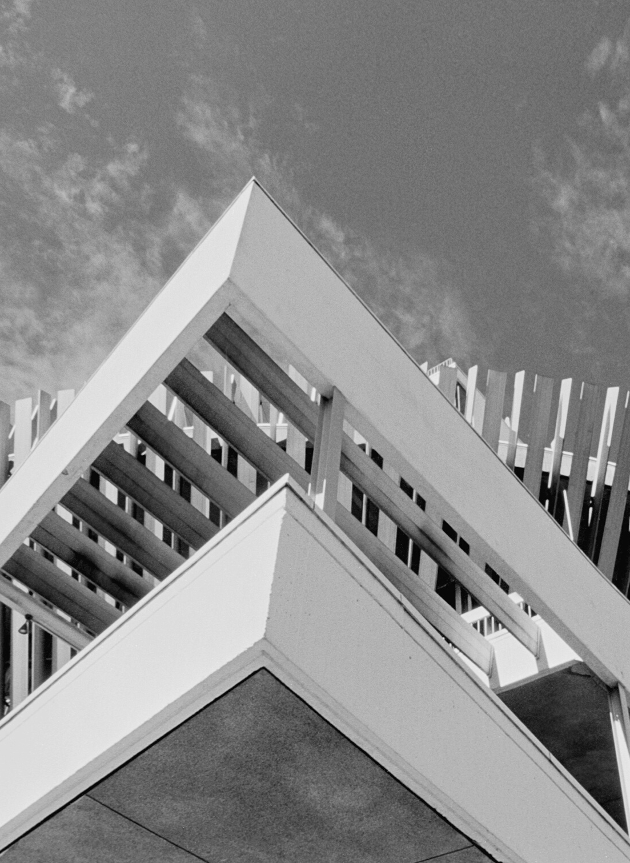
Our Website
The website is designed to provide residents of Bauska with the opportunity to vote for an installations that will be installed in the old city.
Local residents voting
5 projects
One vote per person

Slide 14
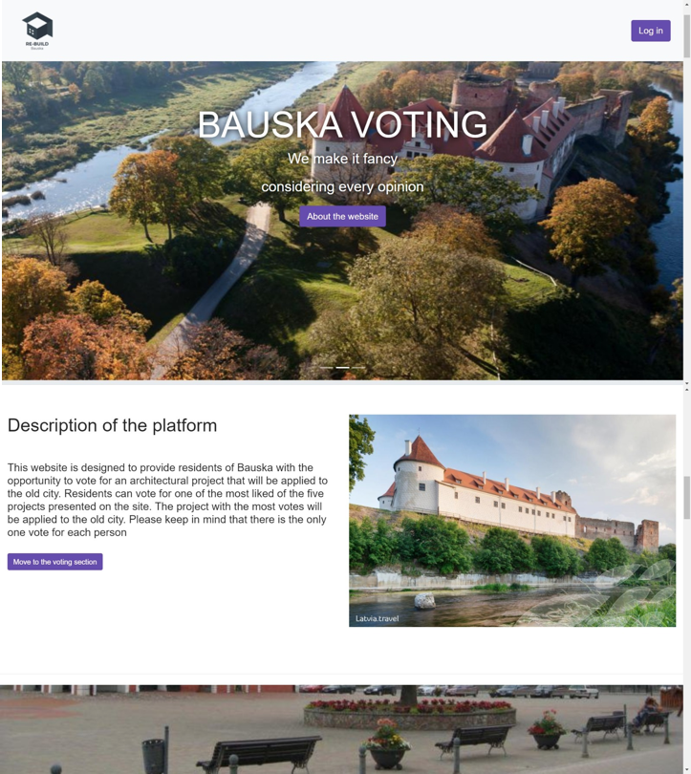
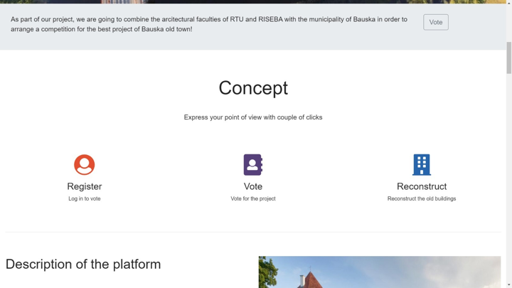
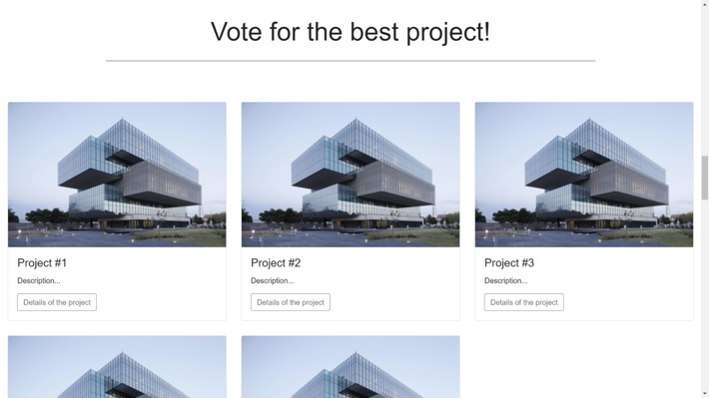

Slide 15
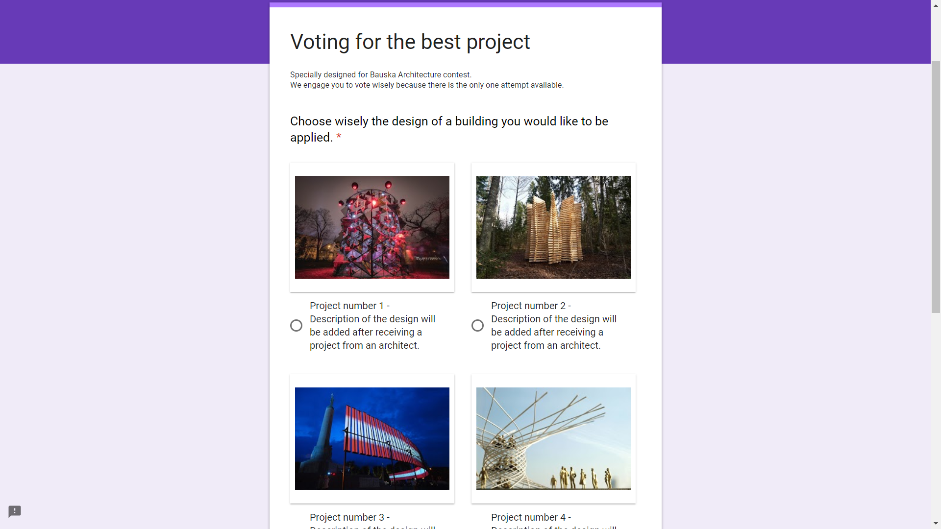
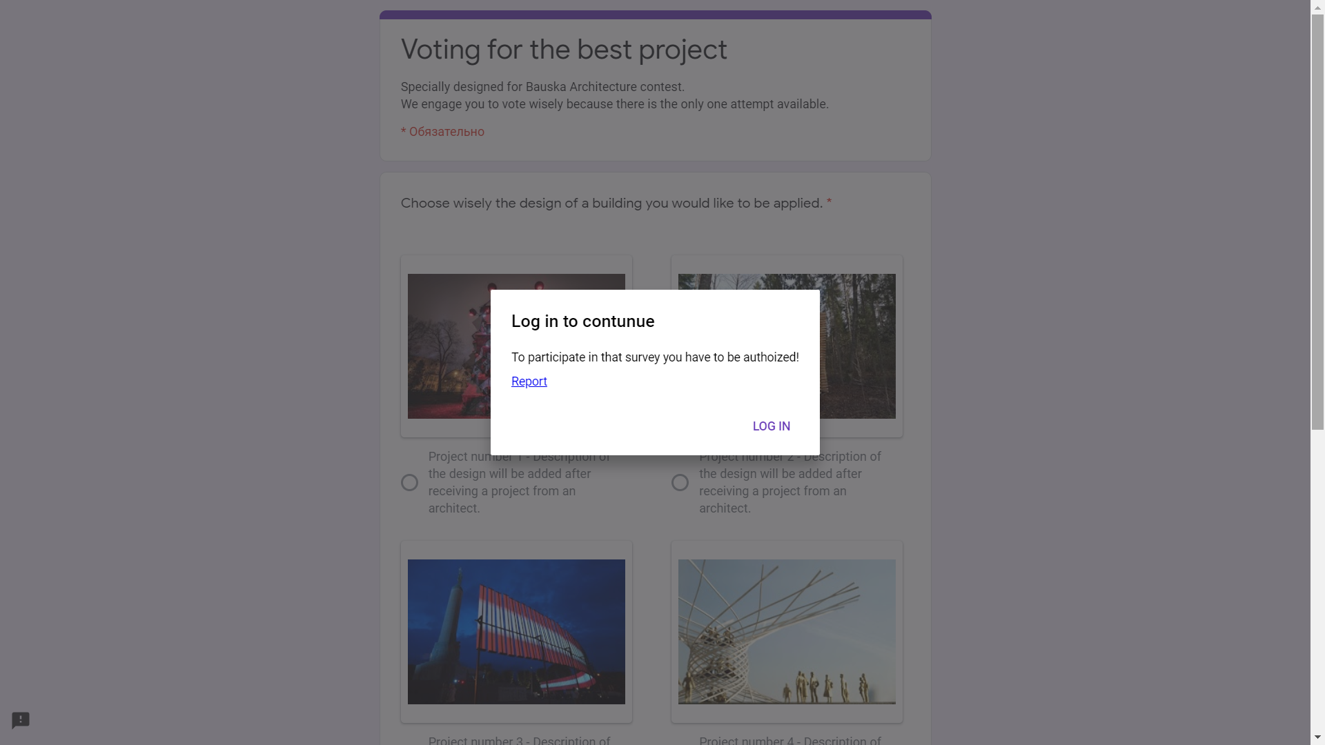
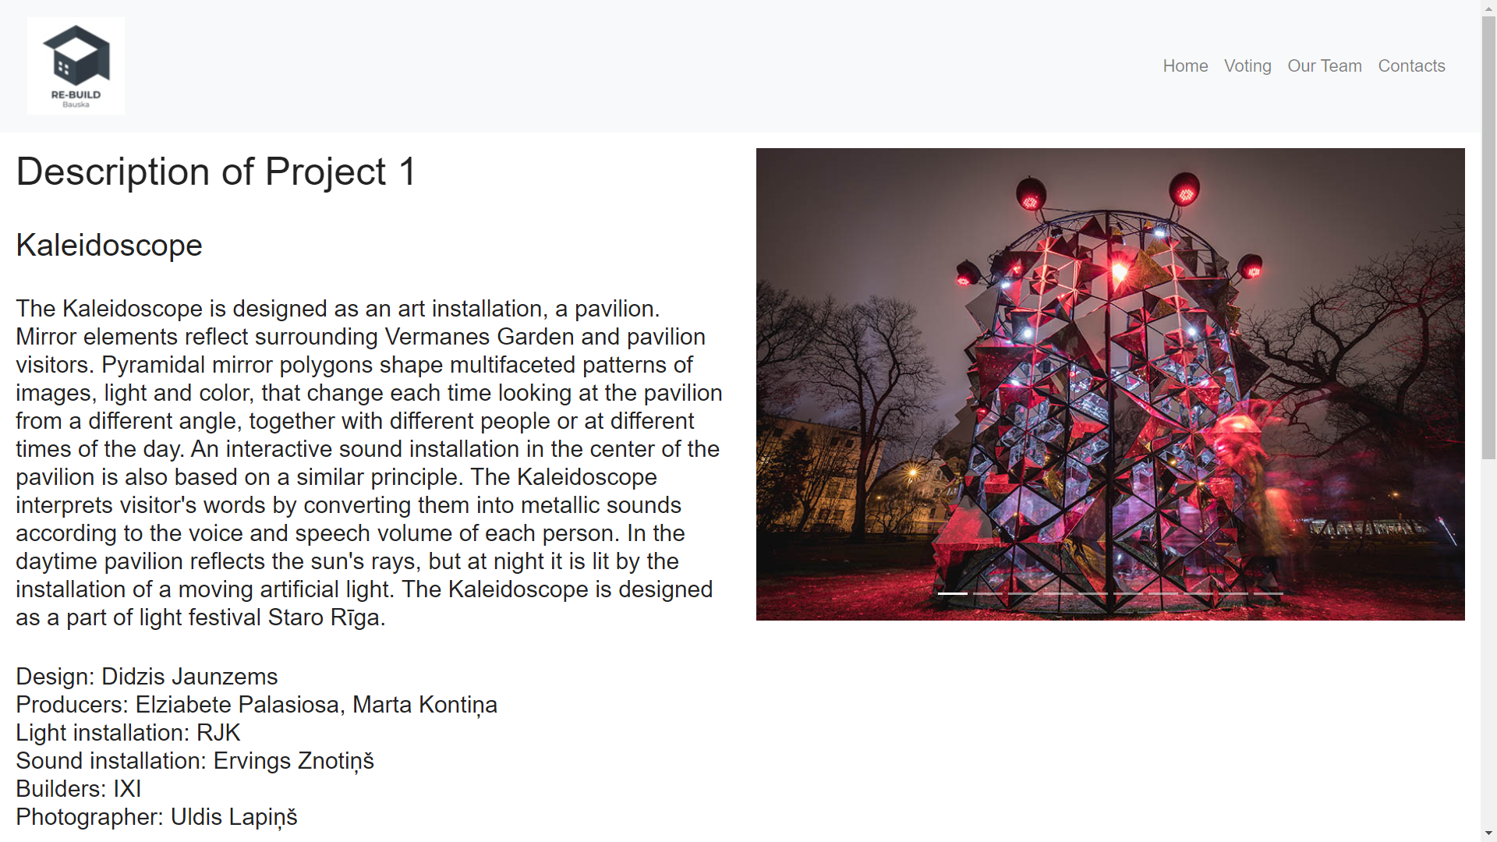
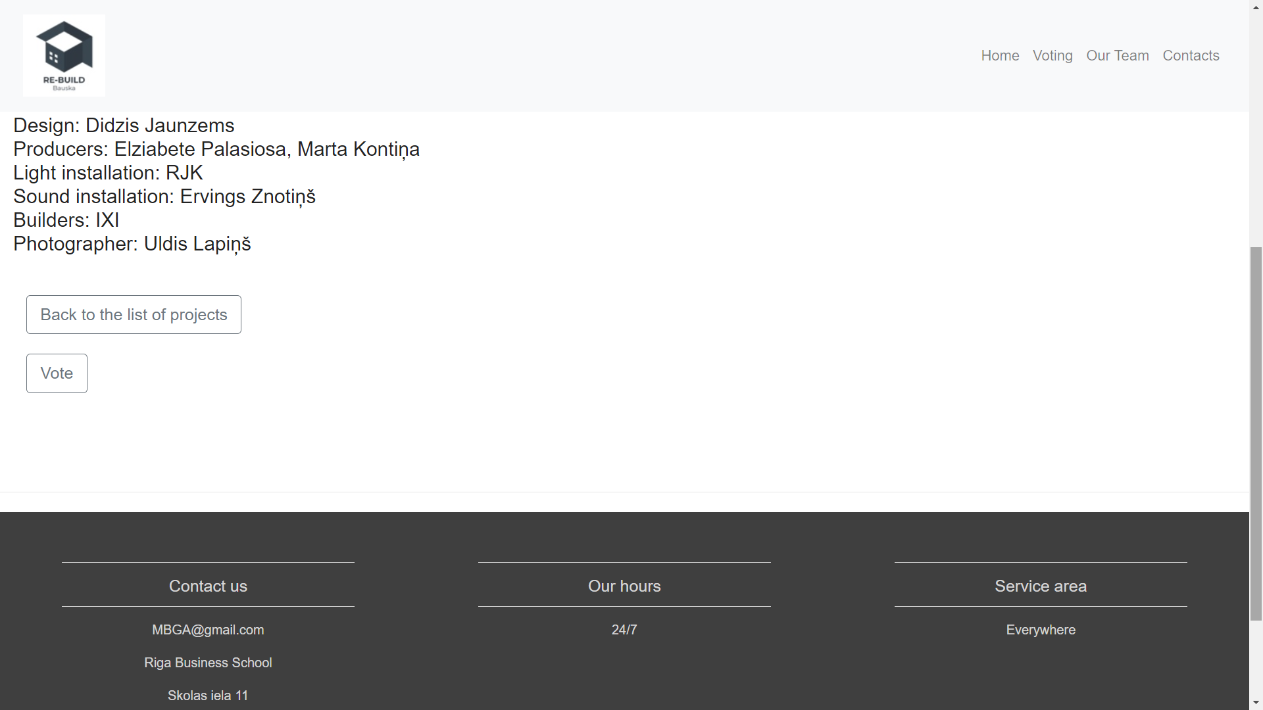

Slide 16
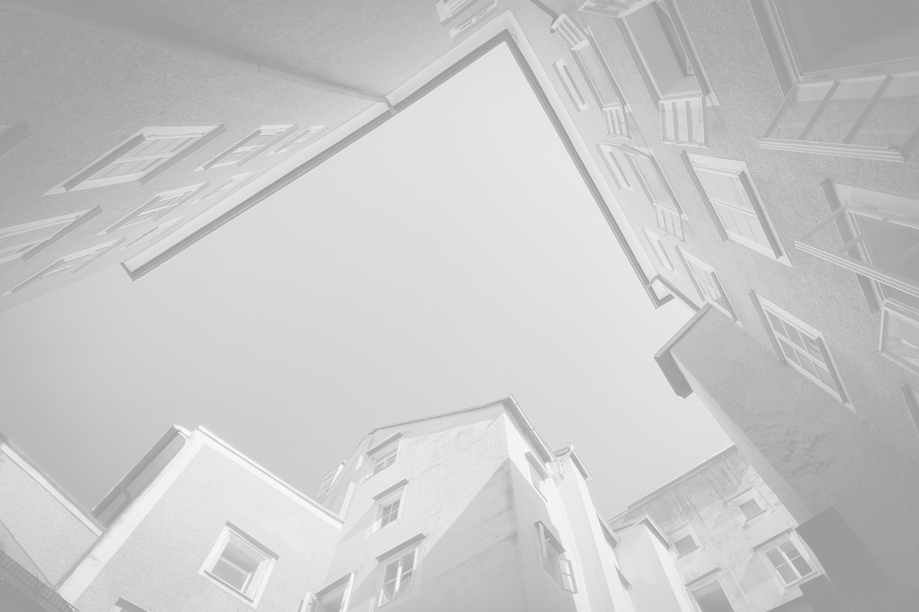




Social Media Links
WEBSITE
FACEBOOK
INSTAGRAM

Slide 17

Future of the Solution
START THE COMPETITION
RECEIVE RESULTS AND ANNOUNCE THEM
ADD REAL PROJECTS TO THE WEBPAGE

Slide 18
Future of the Solution
START VOTING
FINISH VOTING
START CONSTRUCTION

Slide 19
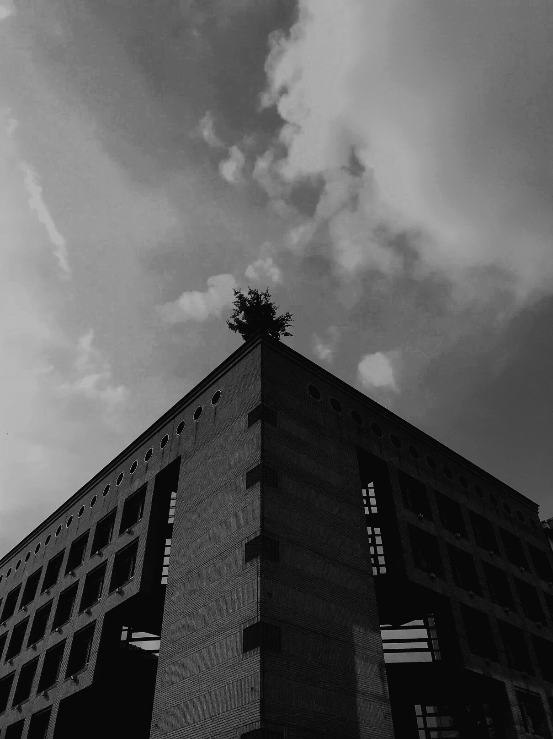




Key Lessons
WHAT WE HAVE LEARNED
There is no need to drive for immediate perfection
Fast feedback is essential
The goal should be obvious
Focus on work not on inactive team members

Slide 20
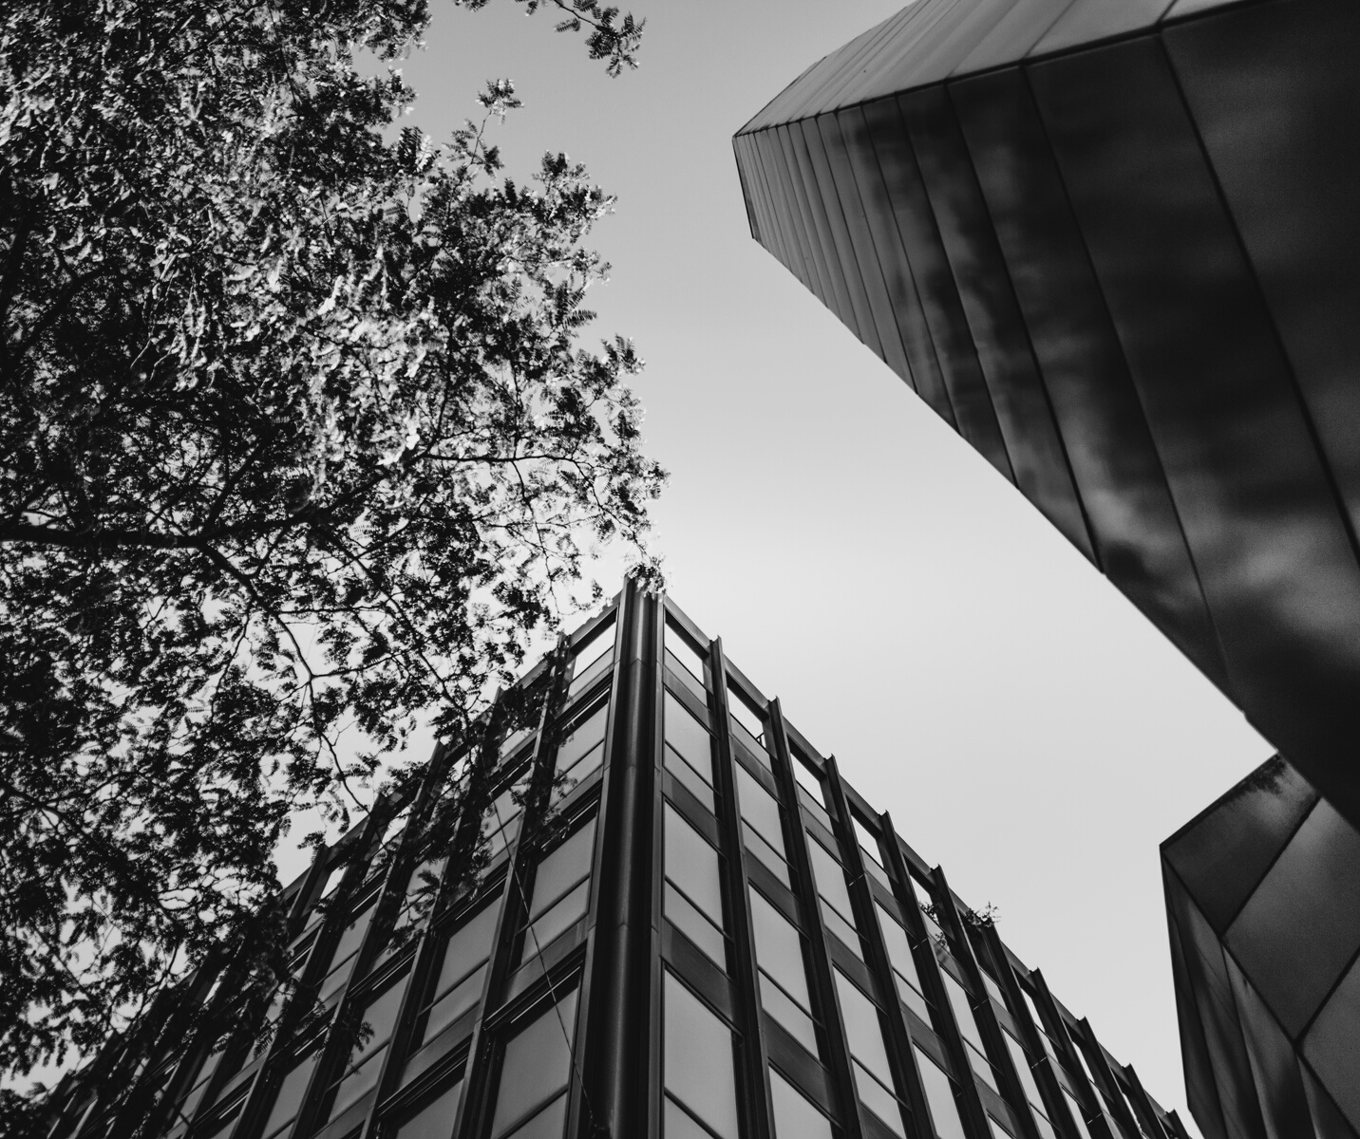
Contact Information
FOR ANY QUESTIONS OR CONCERNS
EMAIL ADDRESSES
sonya214@icloud.com
igors.tatarinovs@gmail.com
l.rozin@regate.lv
marina.tutarashvili@gmail.com
dinazaka@gmail.com
millennial_2000@mail.ru
boris290700@inbox.lv

